Slide 1
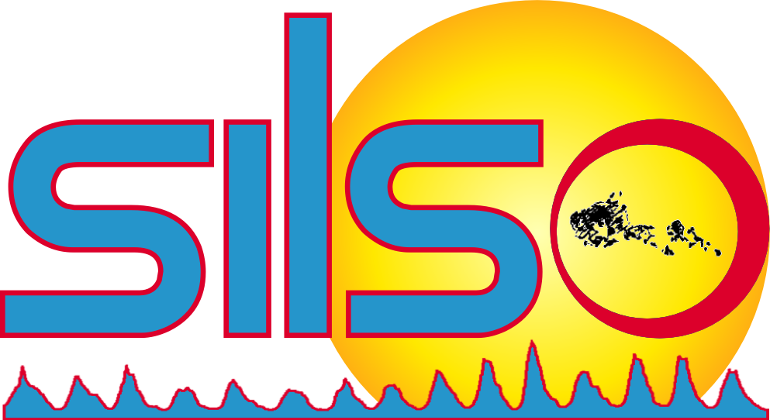
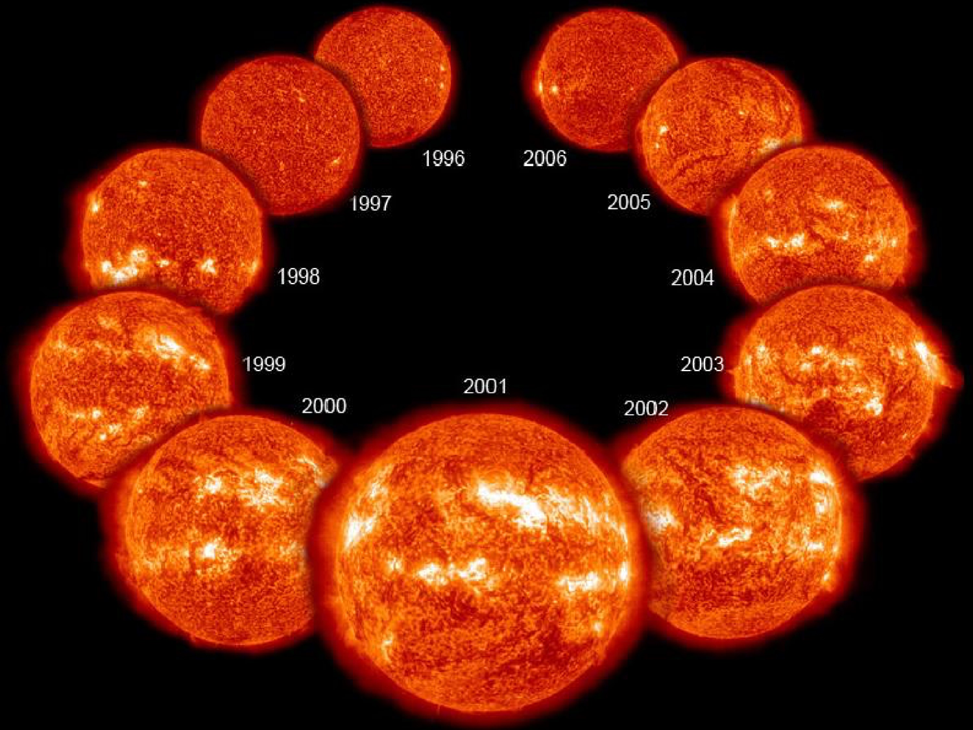
The Sunspot Numbers
SHREYA BHATTACHARYA
Promoter(s): Dr. Laure Lefevre , Dr. Frederic Clette (ROB)
Co-promoter: Dr. Maarten Jansen (ULB)

Slide 2
GUIDING QUESTIONS
Why study the Sun? 🡪 Basic Introduction
What are Sunspots and Groups?
What are characteristic features of Sunspots?
What is a Solar Dynamo?
How Sunspots are formed?
What are Sunspot Numbers?
Why Sunspot Numbers are important?
How Sunspots are observed from the Earth?
What I do?

Slide 3
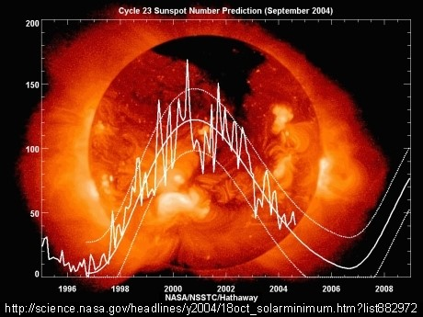
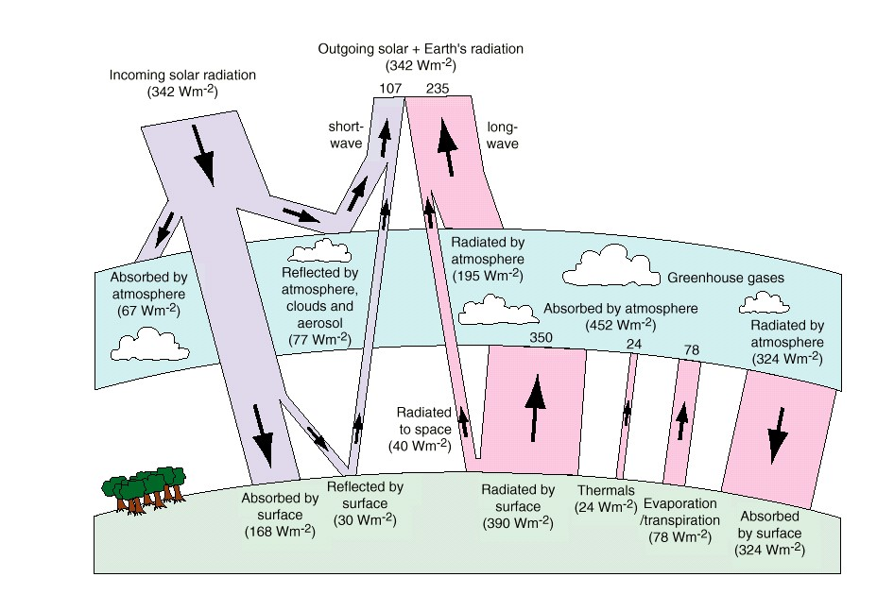
WHY STUDY THE SUN?
The Sun is the energy source of human life and activities. The global change on the Earth may be modulated by the Sun’s activity.
The climate connection

Slide 4
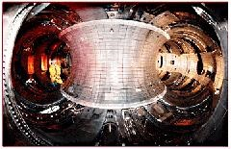
WHY STUDY THE SUN
Thermonuclear reactions in the core of the Sun as well as billions of stars generate enormous amount of energy. Such fusion energy is the future of clean energy.
"Every time you look up at the sky, every one of those points of light is a reminder that fusion power is extractable from hydrogen and other light elements, and it is an everyday reality throughout the Milky Way Galaxy.”
the sun as a physical laboratory

Slide 5
AREA OF INTEREST….
Core - This is the very center of the Sun. The core of the Sun extends from the center out to about 0.2 solar radius.
Radiative Zone: Extends up to about 0.7 radii. Within the radiative zone, the solar material is hot and dense enough that thermal radiation transfers the heat of the core outward through the Sun.
Convective Zone: Heat from inside the Sun is carried up by columns of hot gas. Most stars have a convective zone. In the case of the Sun, it starts at around 70% of the Sun’s radius and goes to the outer surface (the photosphere).
Photosphere: The layer of the Sun that we can see from Earth is called the photosphere.
https://scied.ucar.edu/sun-regions
www.universetoday.com/40631/parts-of-the-sun/

Slide 6
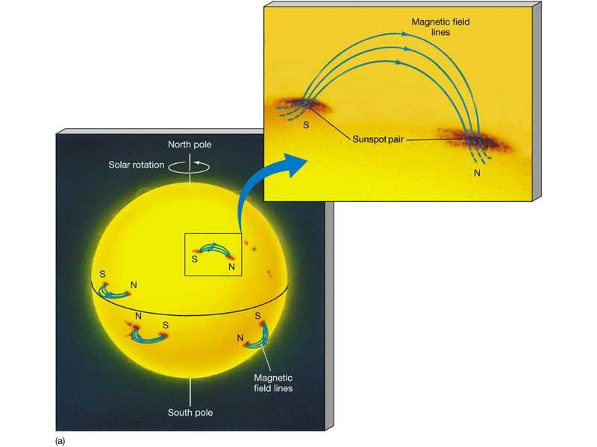
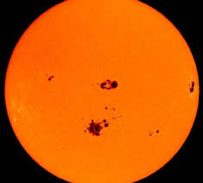
WHAT ARE SUNSPOTS?
Sunspots are darker, cooler areas on the surface of the sun in a region called the photosphere
Sunspots can be very large, up to 50,000 kilo meters in diameter. They occur because Sun's magnetic activity which are not fully understood.
Sunspots occur over regions of intense magnetic activity.
The sunspots usually appear in a pair or a group on sun's surface inside a bipolar magnetic region
https://en.wikipedia.org/wiki/Sunspot

Slide 7
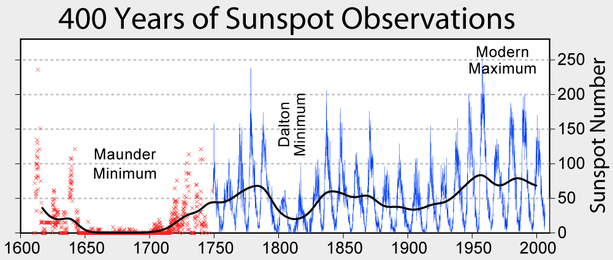
TRENDS SUNSPOTS FOLLOW…
The variation of sunspots along a certain period is known as solar cycle which is approximately about 11years long
The number of sunspots are largest during Solar Maxima and smallest during Solar Minima
But in the 17th century a strange event happened where during a period of 70 years from 1640 to 1710 almost no sunspots were observed.
Cycle After Maunder Minima is Cycle 1
Currently we are in Cycle 25: Started on Jan 2020
https://oneminuteastronomer.com/1042/sunspots-cycles

Slide 8
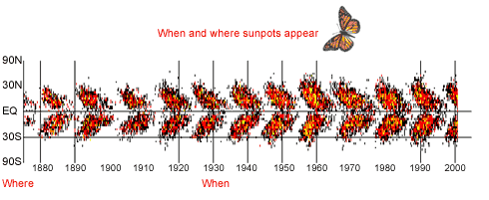
WHERE SUNSPOTS APPEAR?
Surprisingly, almost all sunspots are found in two bands on the Sun, just north and south of the equator. At the start of the cycle, the sunspots appear at latitudes of about 30 degrees, both north and south of the equator.
Then, as the cycle continues, more appear at lower latitudes until, at the end of the cycle, most spots appear near the equator.
If we plot each sunspot's latitude (Y-axis) against the date when it first appeared (X-axis) we get the diagram as shown. This is known as butterfly diagram.
Butterfly diagram.
https://www.earthobservatory.nasa.gov/Features/SolarMax/solarmax_2.php

Slide 9
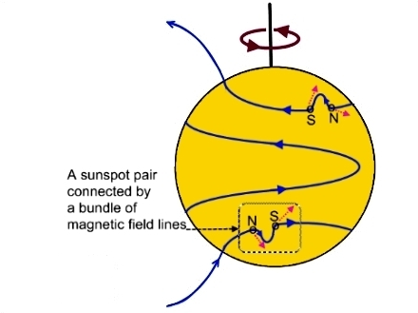
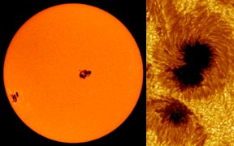
FEW FEATURES OF SUNSPOT..
The sunspots usually appear in a pair or a group on sun's surface inside a bipolar magnetic region (BMR) with strong magnetic field, where the lines of magnetic force are twisted
Their number varies according to the approximately 11-year solar-cycle.
Sunspots have two parts: the central umbra, which is the darkest part, where the magnetic field is approximately vertical (normal to the Sun's surface) and the surrounding penumbra, which is lighter, where the magnetic field is more inclined.
In the sun's northern hemisphere, the preceding sunspot will tend to be closer to the solar equator. The following sunspot will tend to be closer to the sun's north magnetic pole . Thus, they are tilted.
The tilt of sunspots
sunspot’s umbra and penumbra
images courtesy SOHO (NASA & ESA) and the Royal Swedish Academy of Sciences.

Slide 10
HALE’S LAW
Hale (1912) discovered sunspot magnetic fields using the Zeeman Effect (splitting and polarization of emission lines in a magnetic field).
Found that in one hemisphere, one magnetic polarity leads and the other follows, while in the opposite hemisphere the situation is reversed.
Also found that the polarities were reversed after every 11-years, i.e., similar to the Sunspot cycle.
The effective period for the reversal of the Sun’s surface magnetic field was therefore found to be 22- years.

Slide 11
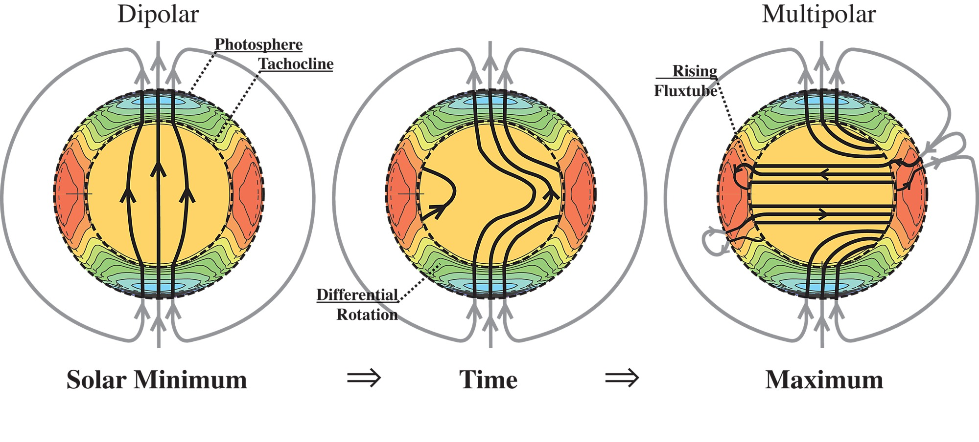
SOLAR DYNAMO
The models that helps us understand the solar magnetic activity are called dynamo models.
Accepted one is the Babcock Model.
The solar magnetism and its activity are generated by differential rotation (Ω effect).
Solar surface activity, such as sunspot cycle, simply follows the variations in the magnetic field.

Slide 12
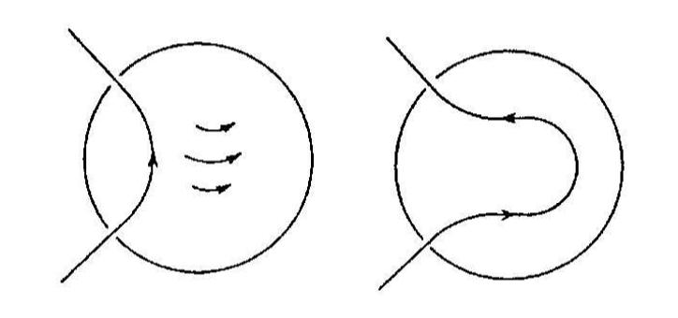
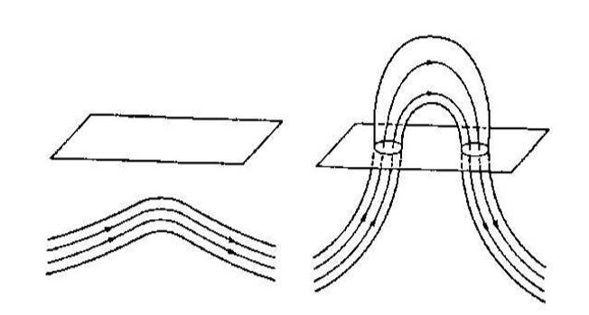
FORMATION OF SUNSPOTS…WITH A TILT
Since the toroidal ﬁeld is generated by the stretching of the poloidal ﬁeld by diﬀerential rotation, we expect the strongest toroidal ﬁelds to be generated in the regions where diﬀerential rotation (i.e. the gradient of angular velocity) is strongest.
It is within tachocline(thin layer at the bottom of the solar convection zone where strong diﬀerential rotation is concentrated) that we expect the strong toroidal ﬁeld to be generated.
If interaction with convection keeps the magnetic ﬁeld in the form of ﬂux tube, then the toroidal ﬁeld generated in the tachocline may be in the form of ﬂux rings going around the rotation axis of the Sun.
Magnetic buoyancy is particularly destabilizing in the interior of the convection zone, where convective instability and magnetic buoyancy reinforce each other. On the other hand, if a region is stable against convection, then magnetic buoyancy can be partially suppressed there.
The combination of magnetic buoyancy and the Coriolis force generates the correct latitudinal distribution of tilt angles,
So by examining the tilt angles, thus the sunspot, we can get some knowledge about the magnetic activity,
An Elementary Introduction to Solar Dynamo Theory
Arnab Rai Choudhuri

Slide 13
IMPORTANT FACTORS FOR SOLAR DYNAMO
Observational Inputs
(Tilt Angles, Sunspot Number)
Helioseismology
Magnetohydrodynamics
(Ampère, Faraday and Ohm’s Laws + Fluid Mechanics)

Slide 14
THE SUNSPOT NUMBER (SSN)
Definition: Proposed by Rudolf Wolf in the 1850s :
R= k (10 ∗ G + S), R = relative SSN, G = number of sunspot groups, and S = number of individual spots and k is a scaling factor (to scale the different observers to the same scale).
Wolf’s journals from 1849
To calculate the relative sunspot number, e.g. on April 4th, one performs R = k * (10*12 + 58) = 178
where the scale factor k was 1.00 for Wolf himself.

Slide 15
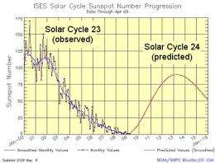
THE SUNSPOT NUMBER (SSN)
Used for :
Solar cycle predictions
Dynamo models
Reconstructions of solar irradiance (solar forcing on Earth climate)
Calibration of long-term proxies (cosmogenic isotope abundances for ex.).
Predictions using Sunspot numbers

Slide 16
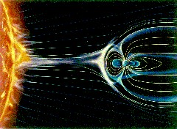
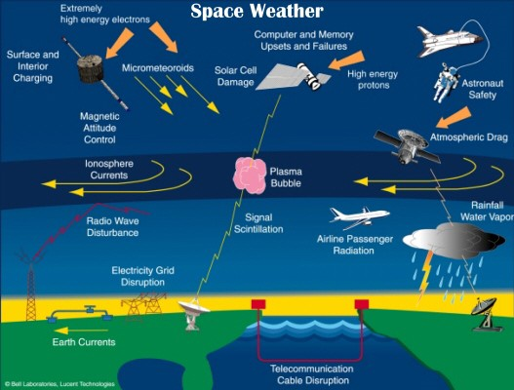
WHY PREDICTING IS IMPORTANT
Streams of charged particles from the Sun lead to adverse space weather and pose threat to our ambition to explore the outer space and solar system.
We may predict space weather by a good understanding of Sun’s magnetic field and its evolution

Slide 17
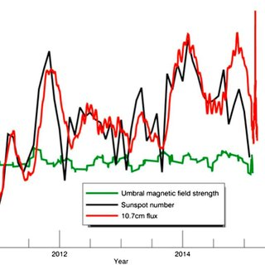
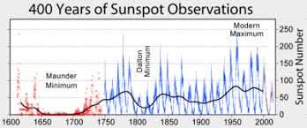
WHY VISUAL SUNSPOT NUMBER
Only index with a long and detailed historical record.
Strong correlation between S_{N} and many recent indices: validity of visual sunspot counts as quantitative measure of solar activity.
More recent indices (Ca-II K index,10.7cm flux, MgII core-to-wing ratio) have a much shorter temporal extent than S_{N}.
Isolated instruments (modern data) = no guarantee of long term continuity.

Slide 18
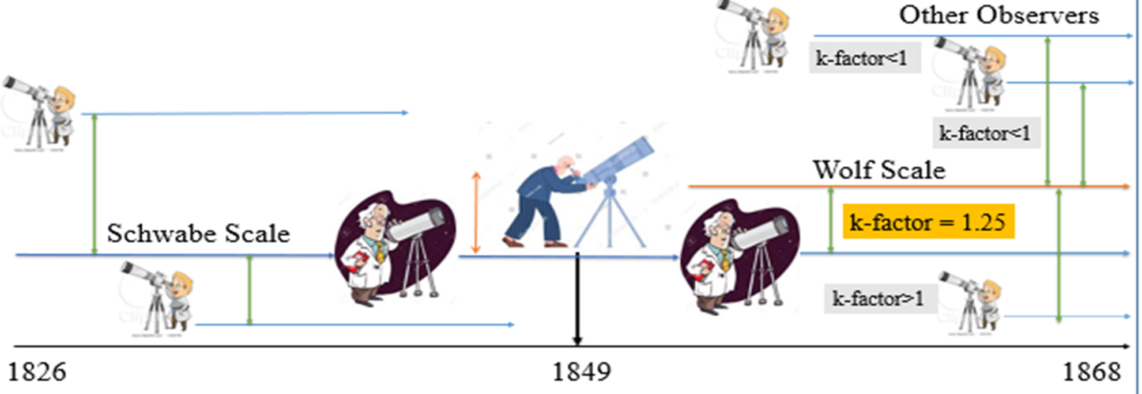
What I do….
1853-1861

Slide 19
WHAT I DO…..
Common series for Solar Dynamo and Space Weather Predictions : Sunspot Number Series
The Sunspot Number introduced by Prof .Rudolf Wolf is a collection of sunspot observations constructed in 1850 + a time series built in real time since then
For this series the time coverage is widely different at different times, the observation techniques, the counting techniques, the instruments, observers eyesight…
k = Wolf Observations/ Observer
My job: Detect discrepancies 🡪 Validate the fallacies🡪 Statistically model it 🡪 Test the robustness 🡪 Hand it over to the Dynamos and Space Weather guys

Slide 20
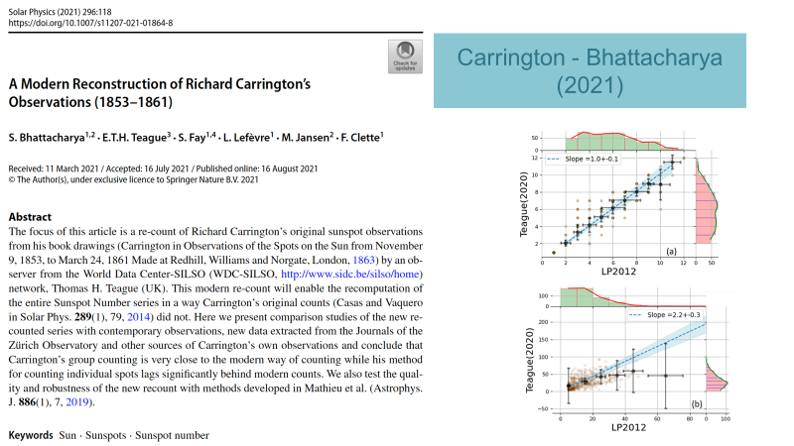
1

Slide 21
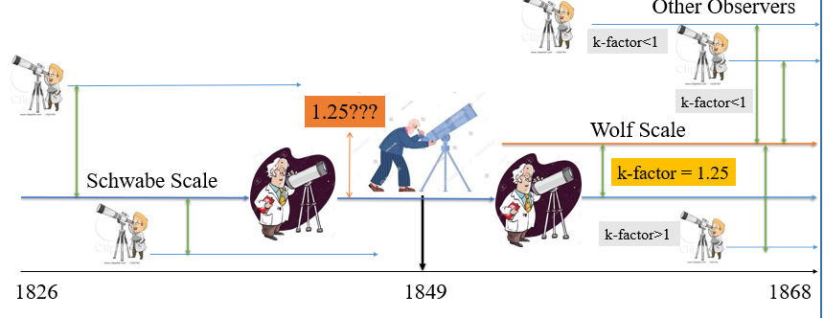
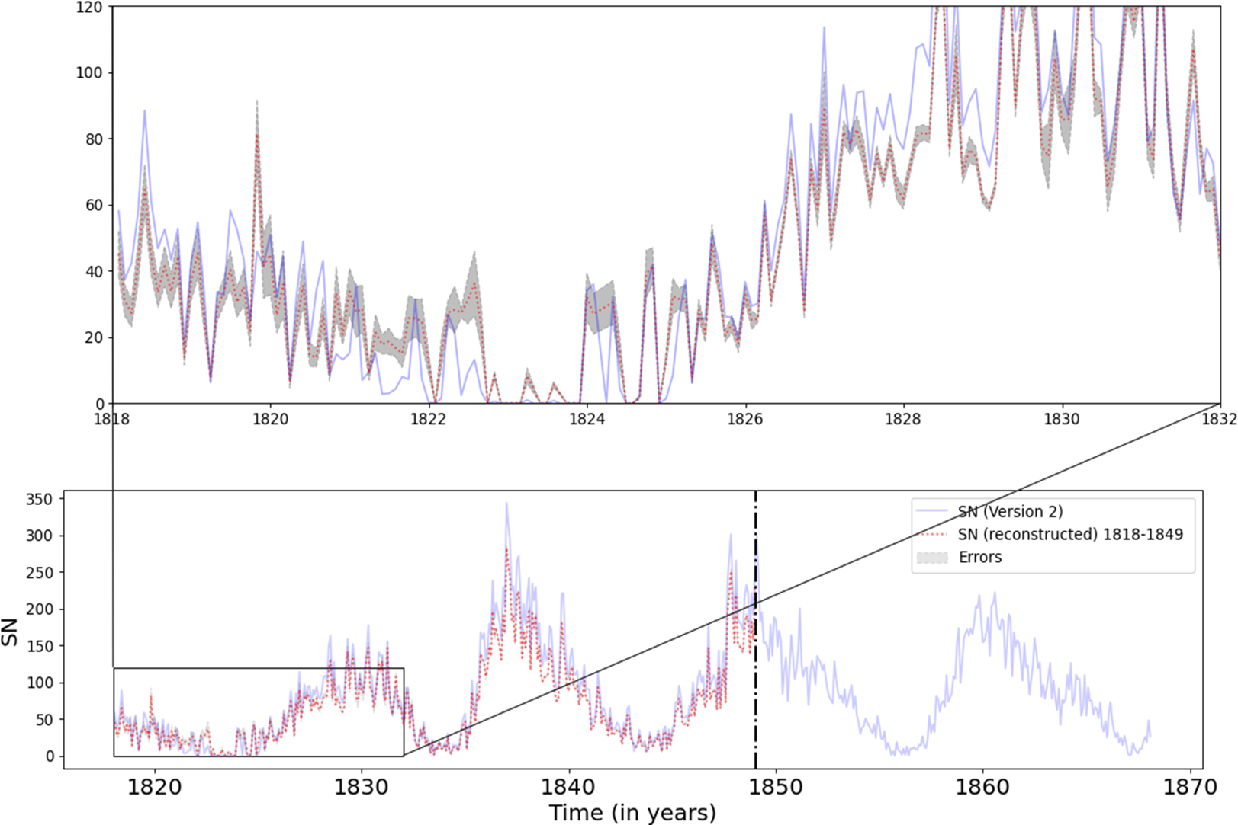
2

Slide 22
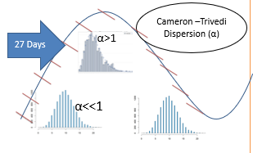
Some Uncertainties….
Daily SN: = k_{_1} y_{_1}+k_{_2} y_{_2}+k_{_3}y_{_3}+…+k_{_n} y_{_n}
Which one is the true value - not only for SN but also for other parameters such as Area or positions?
Proposed Model:
Explanatory Variable: Time
Overdispersed Count data:Sunspot Data (SN/ Area/Position)
Daily Estimated True Value → Fitted values

Slide 23
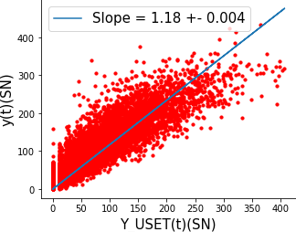
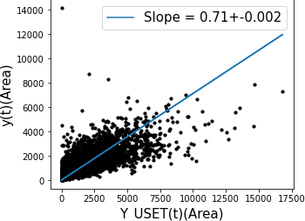
USET Observes 18% less SN compared to true value.
In accordance with Mathieu et al,2019 where USET has 0.8 k-factor
USET records 30% more Area compared to true value.
More catalogs needs to be added

Slide 24
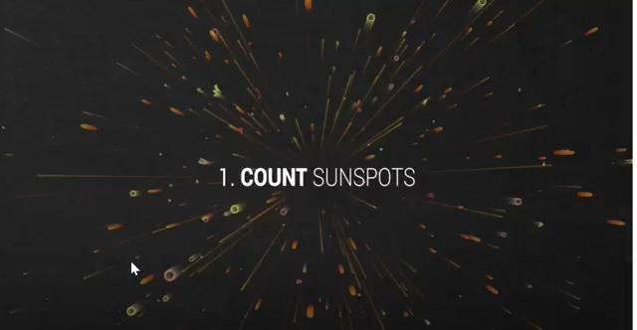
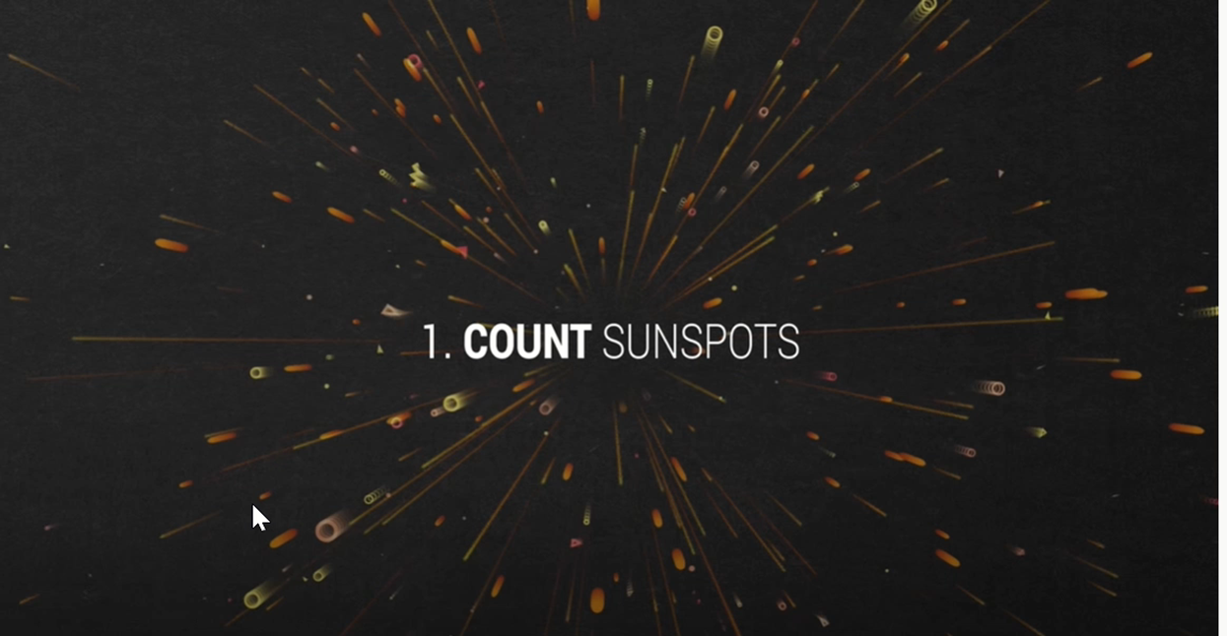
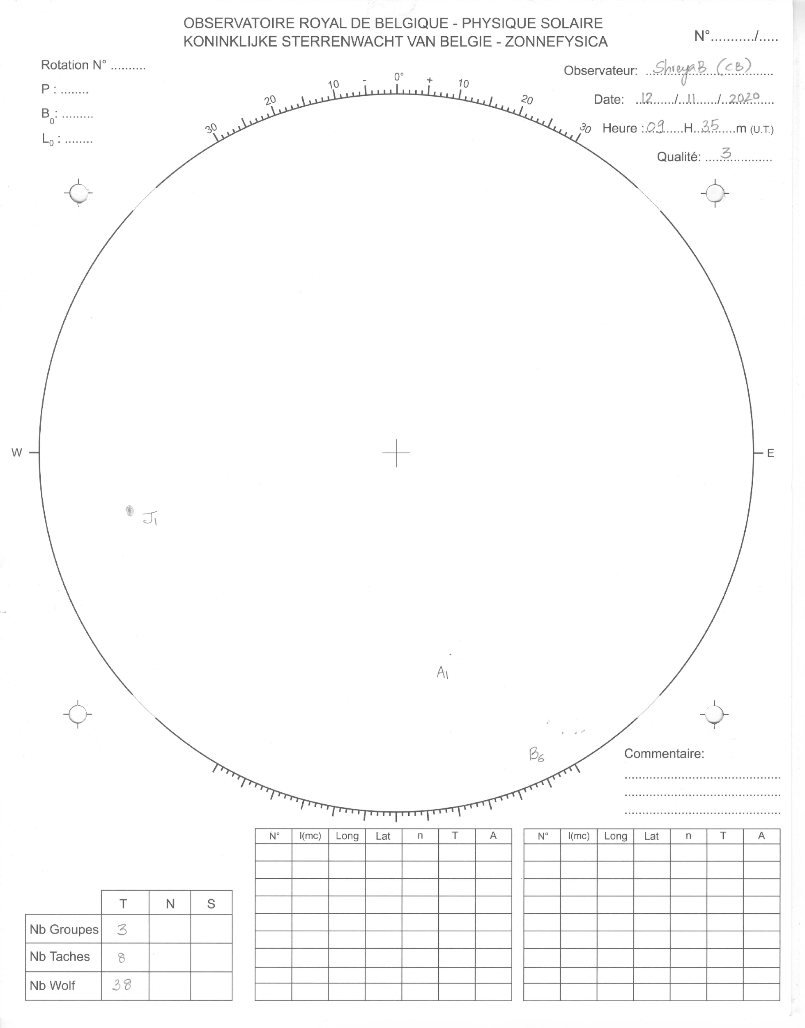
UCCLE SOLAR EQUATORIAL TABLE (USET)

Slide 25
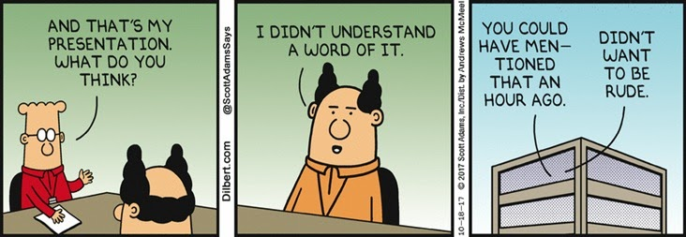
THANK
THANK YOU

